Slide 1
Important Changes in Year 4

Slide 2
Counting of Participant Contact Hours

Slide 3
WIOA Methodology
Once a participant, always a participant
This means, anyone who got 12 hours prior to June 30 stays a participant if you enroll them, with at least 1 direct hour, in the new year
The good – enrollments become a little easier
The bad- these participants now need an MSG in the new year
Hours aren’t “carried forward” if they aren’t a participant in the previous year

Slide 4
Remember…our friend TEAMS
TEAMS
Training activities
Measurable skill gains

Slide 5
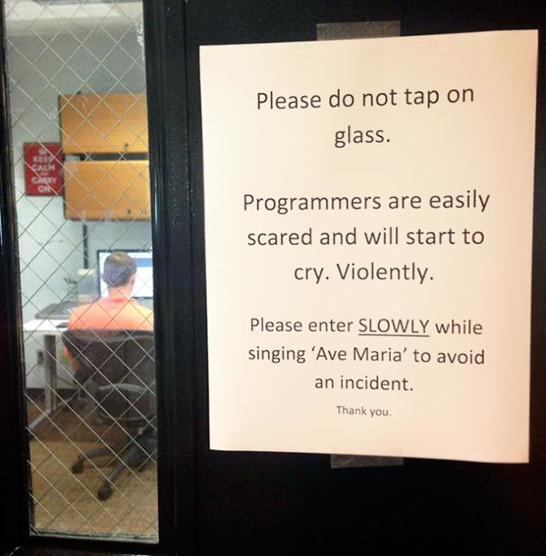
We’re “working on it”
Everything in TEAMS revolves around the school year, so changing to period of participation is essentially a complete system overhaul
We will provide by-participant reports (with all the deets) and “fun” tools to show you who is counting as a participant

Slide 6
Orientation is just that - orientation
Direct Contact Hour:
Hours of instruction or instructional activity the learner receives from the program.
Instructional activity includes
Classroom instruction;
Tutoring; or
Participation in a learning lab.

Slide 7
Deep Breath

Slide 8
Orientation Hours Don’t Count as Direct Contact Hours

Slide 9
Tell me more…

Slide 10
“Career Services” Under WIOA Applicable to AEFLA
Outreach, intake, and orientation information
Initial assessment of skill levels, including literacy, numeracy, and English language proficiency, as well as aptitudes, abilities, and supportive services needs
Referrals to and coordination of activities with other programs and services
Provision of performance information and program cost information on eligible providers of education, training, and workforce services by program and type of provider
Provision of information on availability of supportive services or assistance and appropriate referrals

Slide 11
What does it all mean?

Slide 12
DO NOT USE THE PARTICIPANT PROFILE TO TRACK ORIENATION
NO!
We will be removing this functionality in the near future

Slide 13
Where does it go?

Slide 14
Career Services
v.6.20.17

Slide 15
Career Services Definition\ (OCTAE Program Memorandum 17-2; TEGL 10-16)
Outreach, intake, or orientation information
Initial assessment of skill level or supportive service need
Referral to or coordination of other programs and services
Provision of performance or program cost information
Provision of information on or referral to supportive services

Slide 16
Add a new Career Service
v.6.20.17

Slide 17
Add Career Service Details
No, you don’t have to add assessment info here that is captured on assessment screen
Orientation information will begin to be tracked HERE instead of on participant profile
Services cannot cross the month (for reporting reasons) so a new service must be added if a service lasts across a month

Slide 18
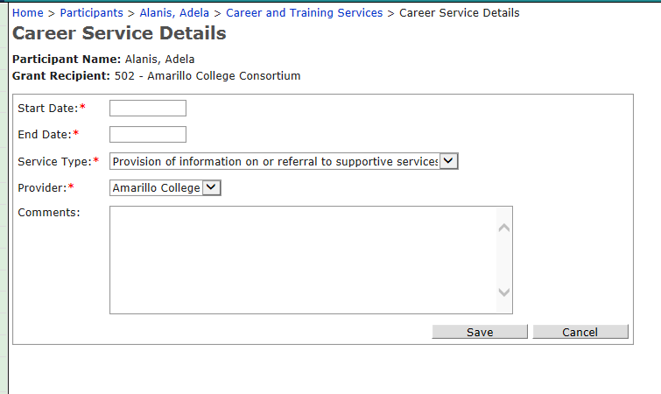
Add Career Service Details (cont’d)
v.6.20.17

Slide 19
Distance Learning Call Center

Slide 20
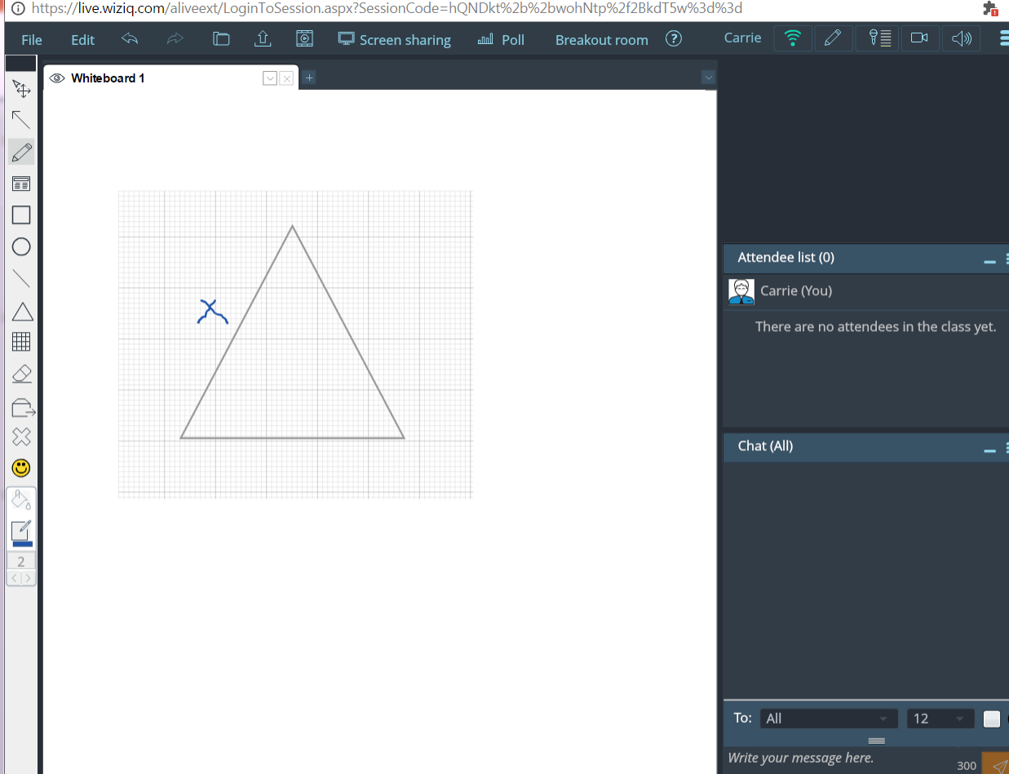
Screenshot
Open to ALL participants
Non-AEL Participants can participate – they just have to answer a few eligibility questions

Slide 21
But we want the contact hours….

Slide 22
Really really really rough guidance. (we will be sending out “formal guidance” very soon)

Slide 23
How to count contact hours for call-center participants
First, these are direct hours, because the instruction is synchronous, but only the time they are in the system is counted.
The instructors are “valid” (have the appropriate credentials and get the necessary staff development)

Slide 24
Steps…(again, really really rough!)
You would enter into an agreement (ex MOU) with StudentNest to use their staff as “volunteers”
We will add the initial record for each staff member to TEAMS but no employment details
You would add the staff to employment under your grantee (so, each staff member with StudentNest may have many employment records)

Slide 25
More steps…
You will need to set up a class (you can set up one with all the instructors)
You will need to get a transcript from the student upon class time completion – this is the “sign-in sheet”
You will log the hours in TEAMS.

Slide 26
Recruitment!
We’re working on direct-mail to students with their TEAMS record number and login-information; similar process for teachers and the record numbers of students in their class(es)
You can target:
Individuals who are not TSI ready in math
Individuals leaving HSE testing centers who aren’t math-ready

Slide 27
Local/Other Funds

Slide 28
Using Local/Other Funds
An AEL letter is in the works with the “official” details.
You cannot count instructional time funded with local funds.

Slide 29
What this change means…
If you are using local funds:
We recommend you use them for non-instructional costs
If you really really want to use local funds for instruction, you have to cost-allocate and that proportion of contact hours won’t count
Example: if you pay for an instructor with 30% local funds, you can only count 30% of the direct hours in the class
This is not the case for training hours which we know will utilize self-pay or other funds

